Slide 1

Yamba Media
ABOUT US
Yamba Media

Slide 2
services guide
Yamba Media
OUR SERVICES
brand identity
web design
photography
social media management
printing
servives
videograghy
consultation
audio

Slide 3
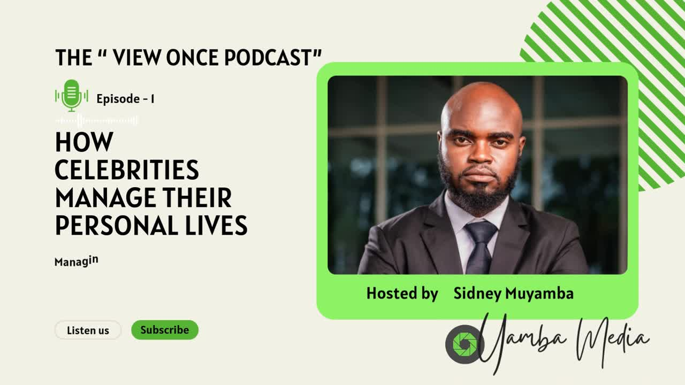
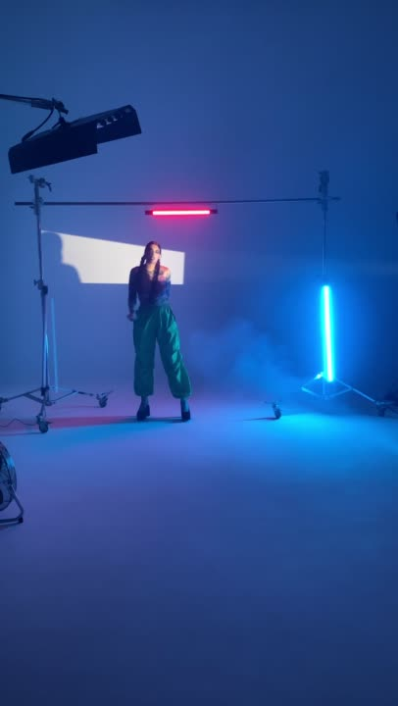
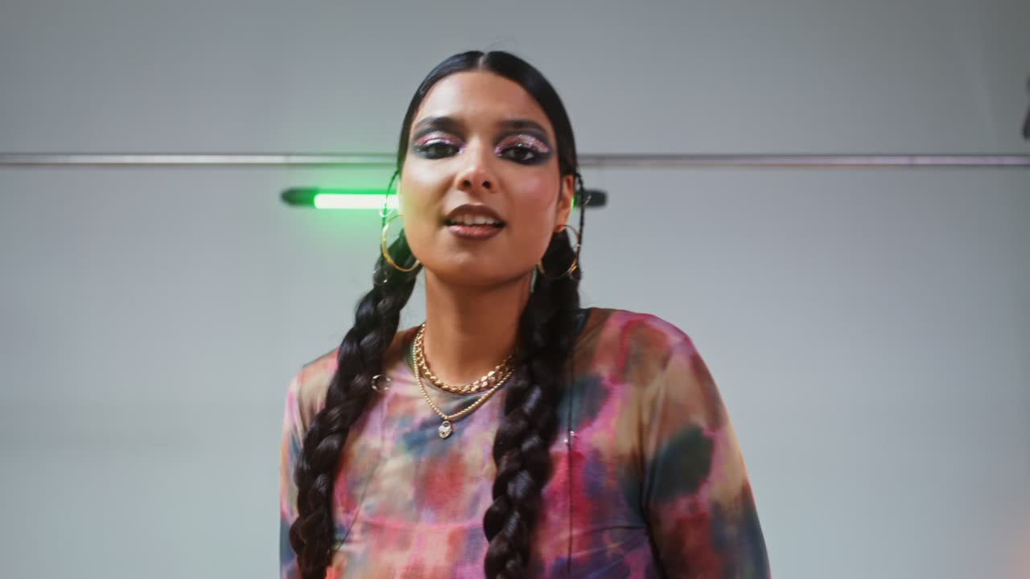
What We're Up To
Podcast
Make Your Way
Unscripted
LISTEN TO SEASON 1
WATCH THE FILM
WATCH THE PLAYLIST

Slide 4
Hello,
Sidney here!
Sidney's story started back in 2022 as a passion project of making relevant and creative content for all. 3 years later, what started as a passion project between friends has turned into a full-blown organization that's become the home of about 100 creatives, from producers and directors to writers, editors, and talent.
We all have one mission - to create stories and amplify narratives that matter.
Whether it's fiction or nonfiction, drama or comedy, the company's projects all hinge on the belief that being truthful and authentic is of utmost importance.
Craving for content that speaks to you?
Welcome to Yamba Media. We're gladly you're here.
"Authenticity is of utmost importance."
I. Olowe
Sidney Muyamba, CEO of Yamba Media

Slide 5

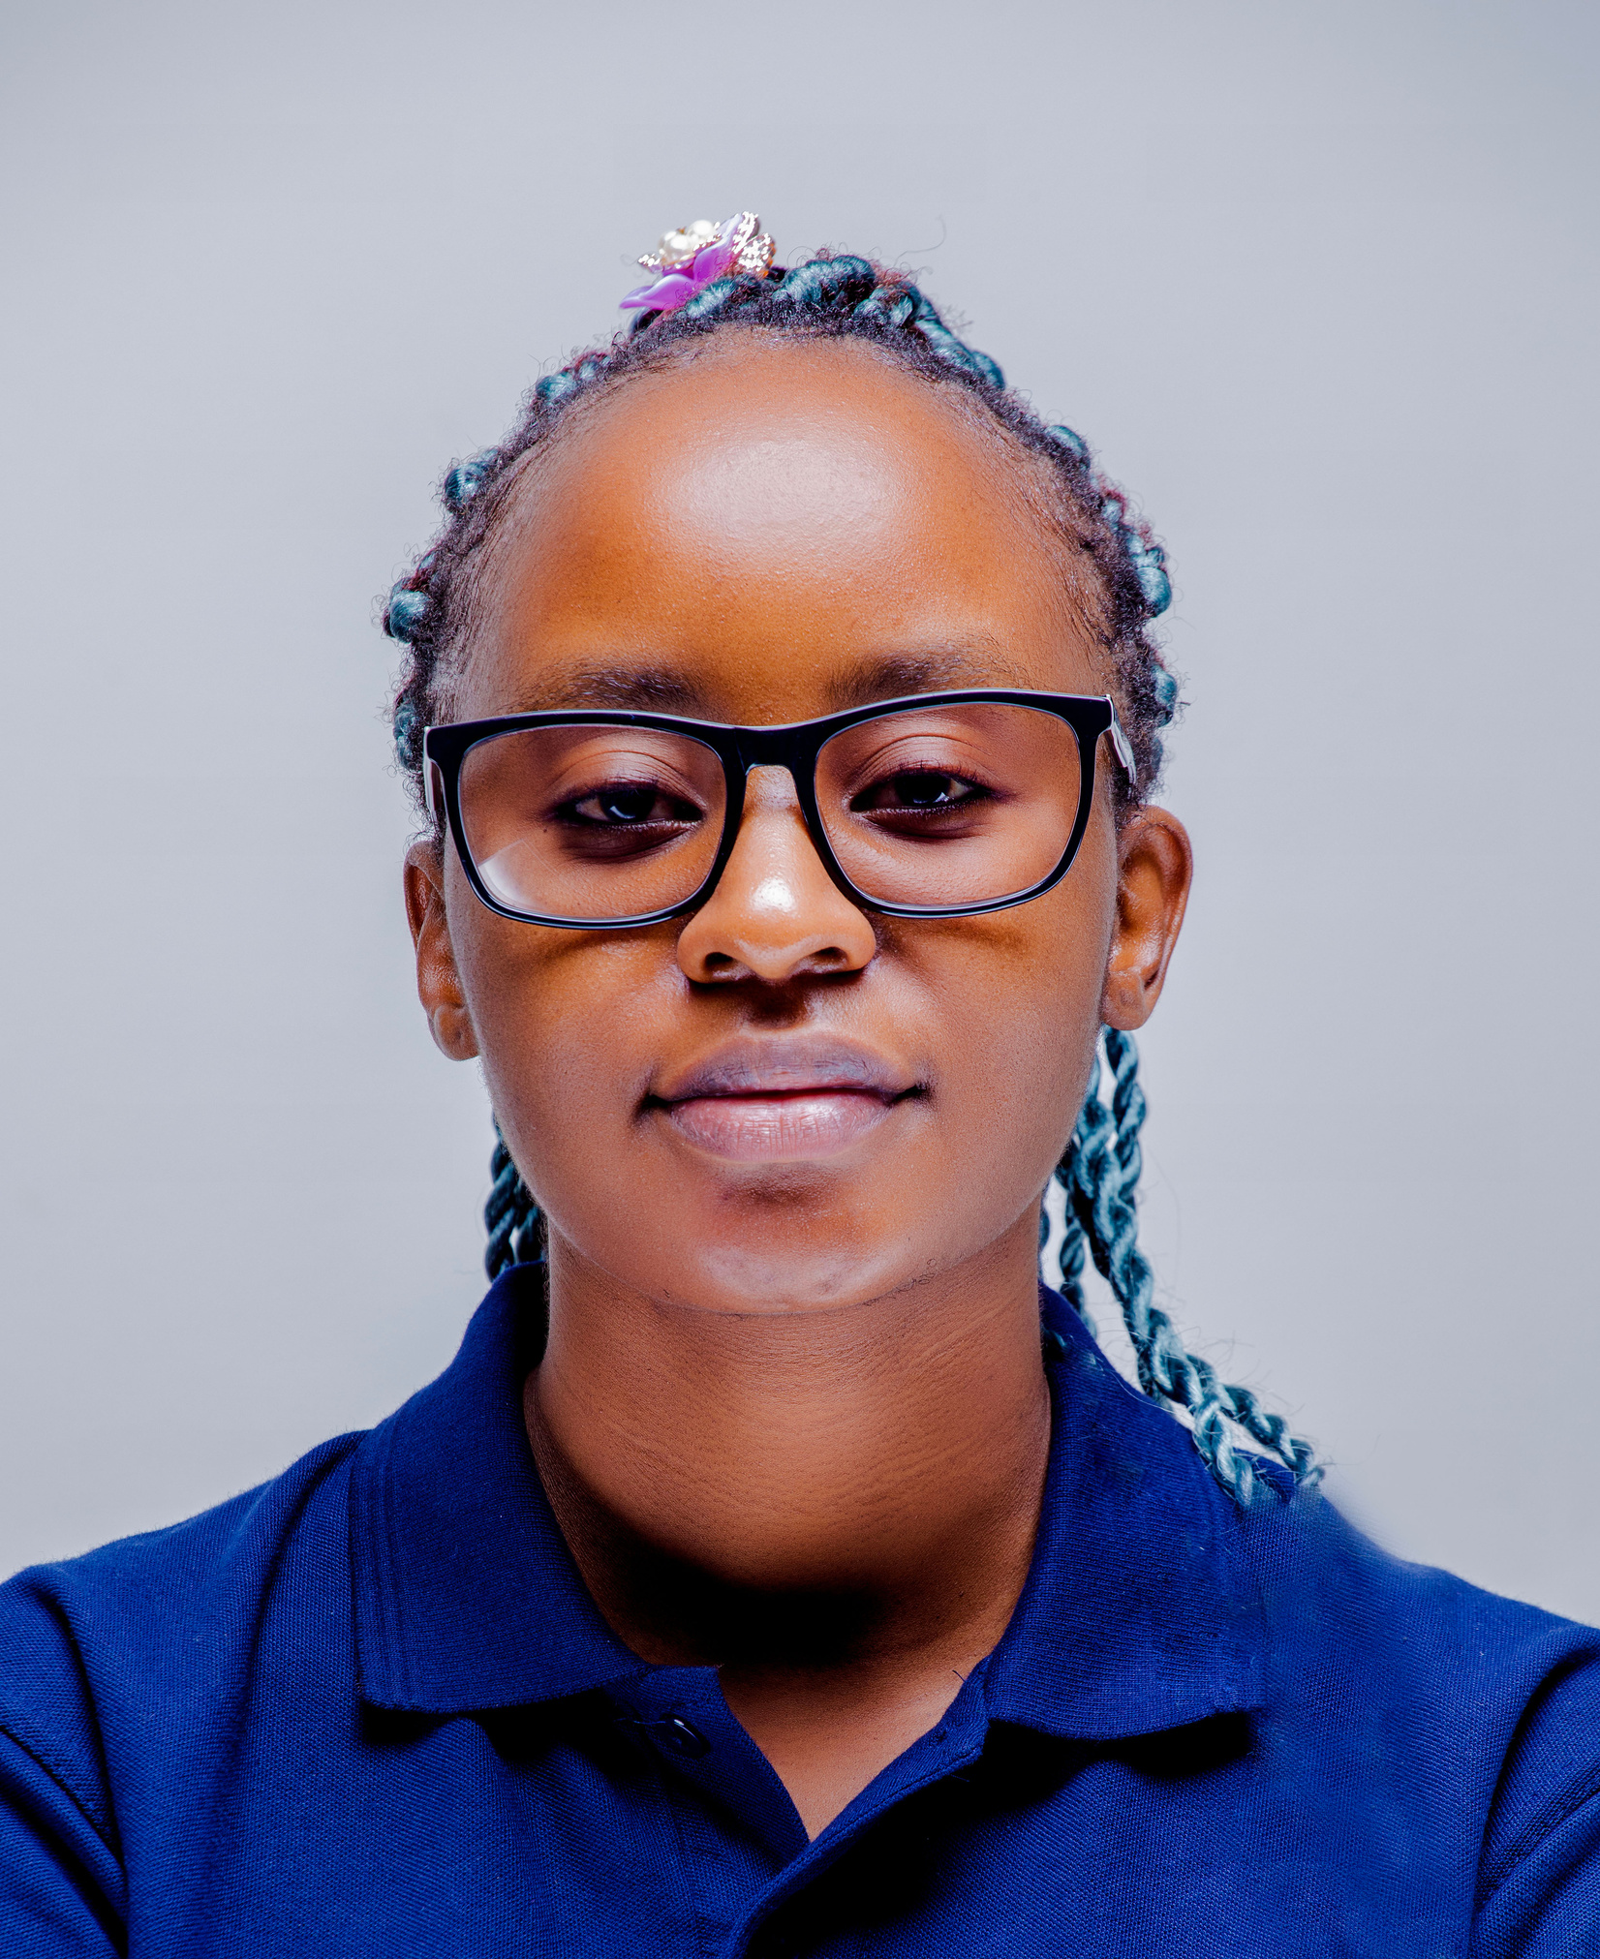

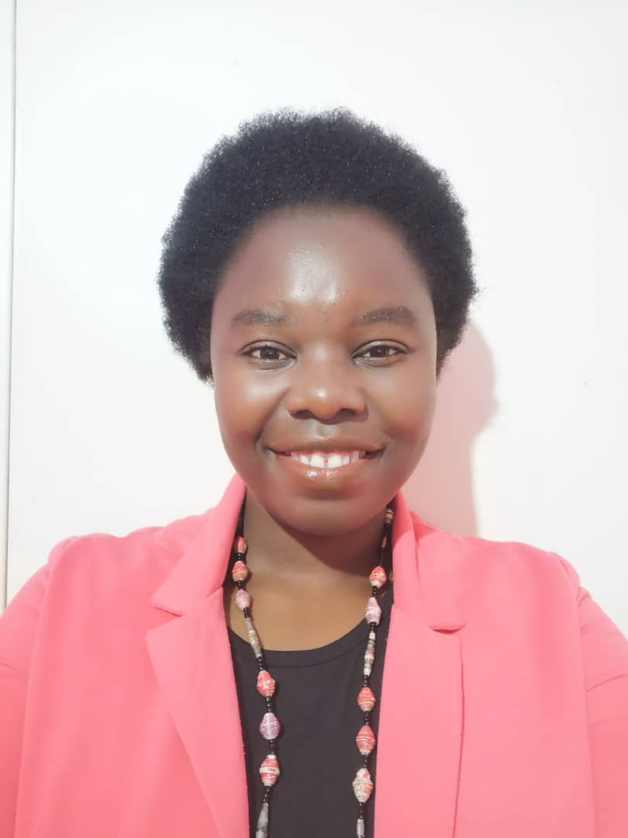

Yamba Media
2025
OUR TEAM
Meet the creative minds behind
Sidney Muyamba
Jacqueline Haankwenda
Jordan Muyembi
Susan Chileshe
Milimo K. Mukkuli
Founder & Creative Director
Strategic Consulting
Video Editor & Director
Production Codinator
Digital & Web Content

Slide 6


Heliotrope Premieres Crowdfunded Short Film
Hot Off The Press
Add a short description of the newsworthy event
READ MORE
Digital Media Darling Heliotrope names President
Add a short description of the newsworthy event
READ MORE
A Rare 1-on-1 with CFO Jasmine Pedraza
Add a short description of the newsworthy event
READ MORE

Slide 7
You're Part of Our Story
YAMBA MEDIA is a leading full-service creative agency and production house based in Lusaka, Zambia, specializing in bringing brands and stories to life across all visual, audio, and print platforms. We offer an integrated suite of services, providing end-to-end solutions for businesses, organizations, and individuals seeking impactful communication.
At YAMBA MEDIA, we are your creative and printing partner, committed to delivering exceptional quality, innovative solutions, and seamless project execution. Our dedication to local talent, combined with our diverse in-house expertise, ensures your brand or message stands out in every format, empowering your vision from concept to final print.
Heliotrope's story is yours.
Our Philosophy:
CREATIVITY FROM A
DIFFERENT PERSPECTIVE

Slide 8





Yamba Media
Ready to take your brand to the next level? Contact us today!
SUBSCRIBE
hello@yambamedia.zm
Socials

